Slide 1



ML/DL for Everyone with
Lecture 3: Gradient Descent
Sung Kim <hunkim+ml@gmail.com> HKUST
Code: https://github.com/hunkim/PyTorchZeroToAll
Slides: http://bit.ly/PyTorchZeroAll

Slide 2

Call for Comments
Please feel free to add comments directly on these slides.
Other slides: http://bit.ly/PyTorchZeroAll
Picture from http://www.tssablog.org/archives/3280

Slide 3
ML/DL for Everyone with
Lecture 3: Gradient Descent
Sung Kim <hunkim+ml@gmail.com> HKUST
Code: https://github.com/hunkim/PyTorchZeroToAll
Slides: http://bit.ly/PyTorchZeroAll

Slide 4
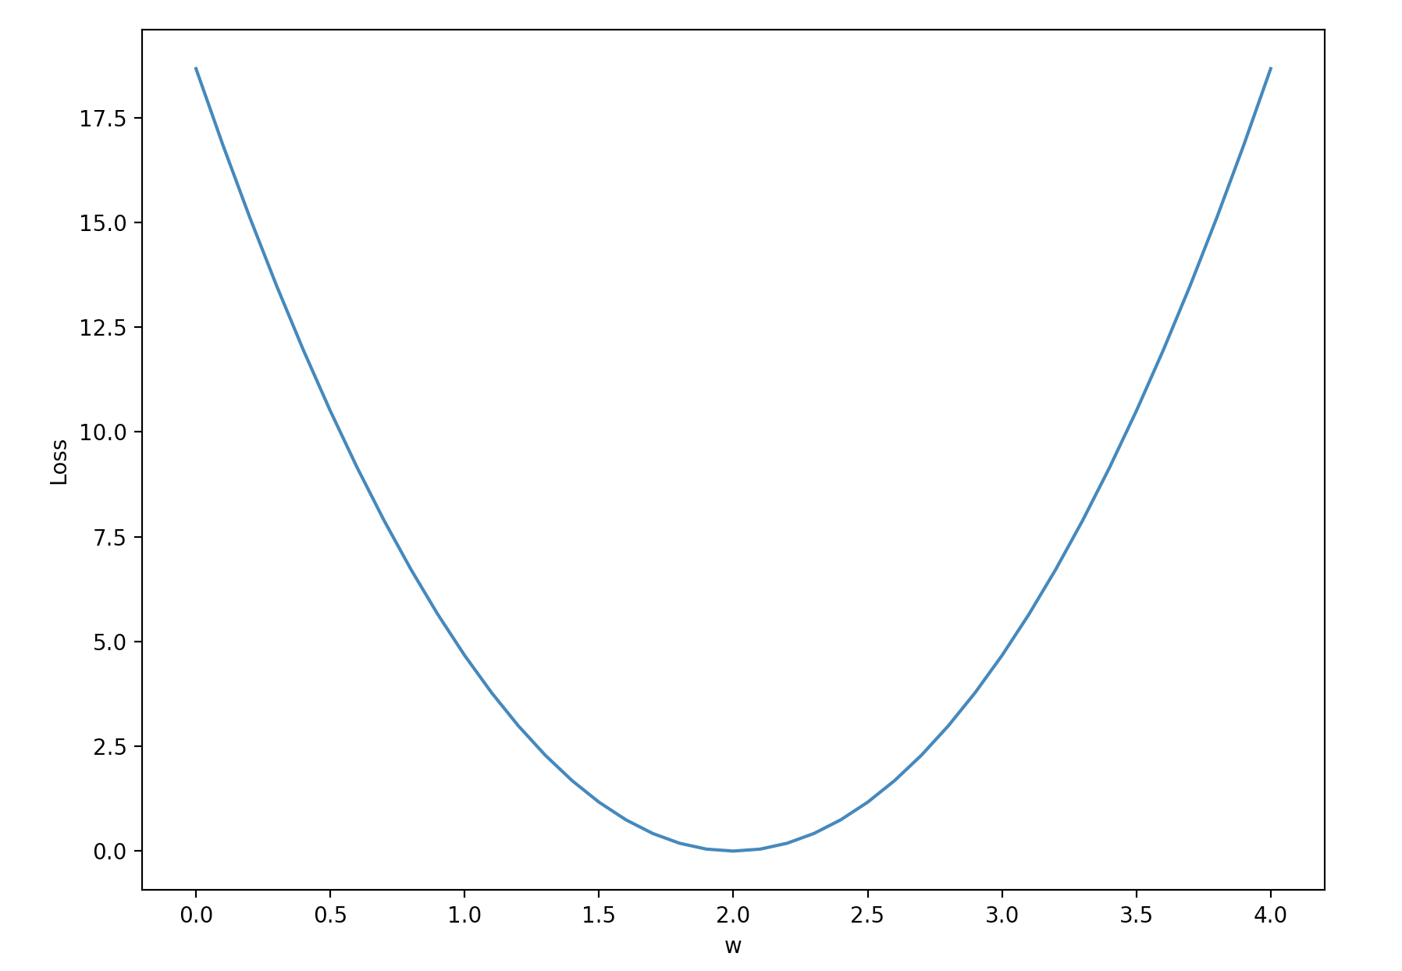
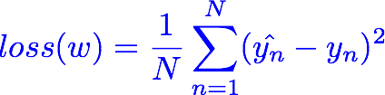

Loss graph
Loss (w=0) | Loss (w=1) | Loss (w=2) | Loss (w=3) | Loss (w=4)
mean=56/3=18.7 | mean=14/3=4.7 | mean=0 | mean=14/3=4.7 | mean=56/3=18.7
Notes:
loss = (\hat{y}-y)^2 = (x*w-y)^2

Slide 5
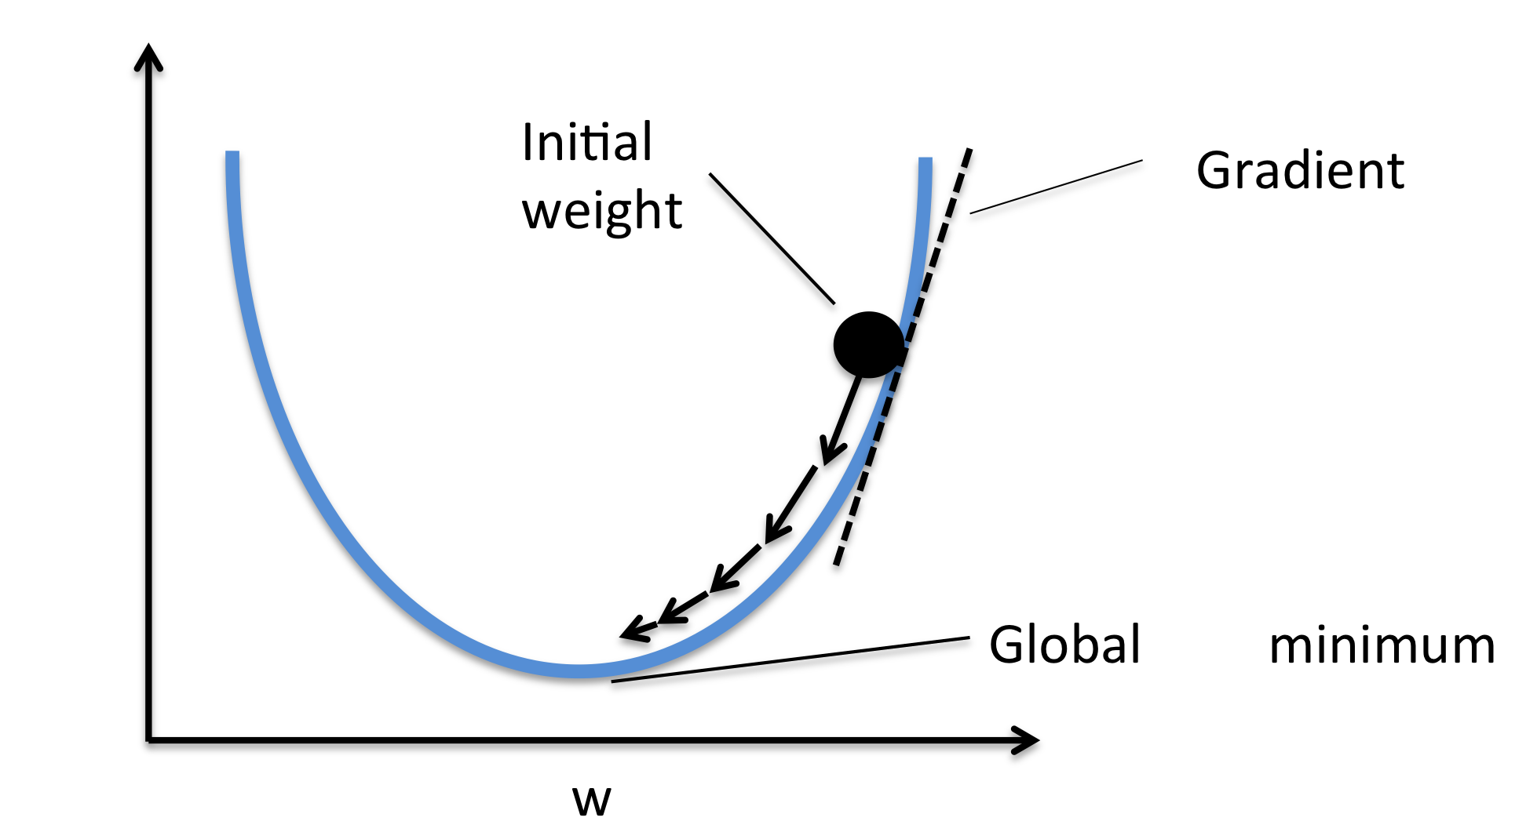



Gradient descent algorithm
loss
loss
Notes:
loss = (\hat{y}-y)^2 = (x*w-y)^2
\frac{\partial{loss}}{\partial{w}}=?

Slide 6
Derivative
Notes:
loss = (\hat{y}-y)^2 = (x*w-y)^2
\frac{\partial{loss}}{\partial{w}}=?

Slide 7

Derivative
Notes:
loss = (\hat{y}-y)^2 = (x*w-y)^2
\frac{\partial{loss}}{\partial{w}}=?

Slide 8
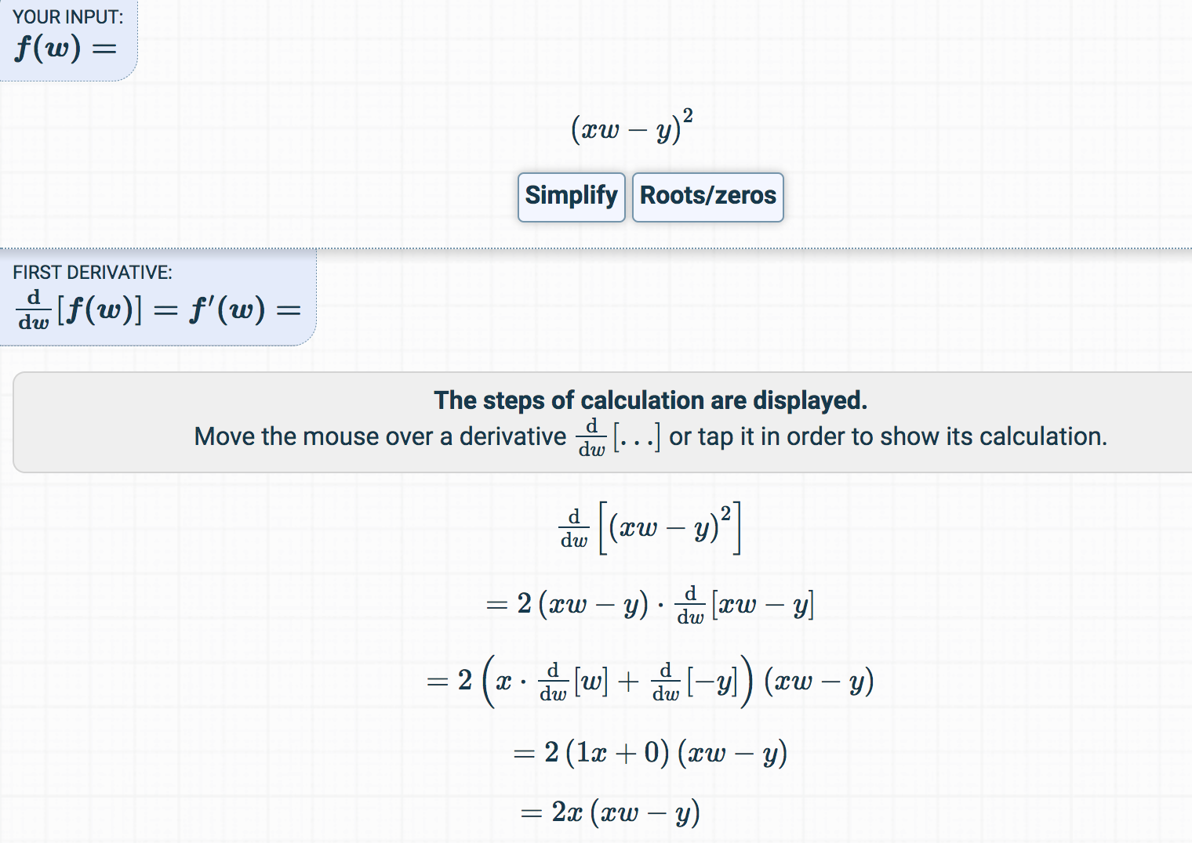
Derivative
https://www.derivative-calculator.net/
Notes:
loss = (\hat{y}-y)^2 = (x*w-y)^2
\frac{\partial{loss}}{\partial{w}}=?

Slide 9

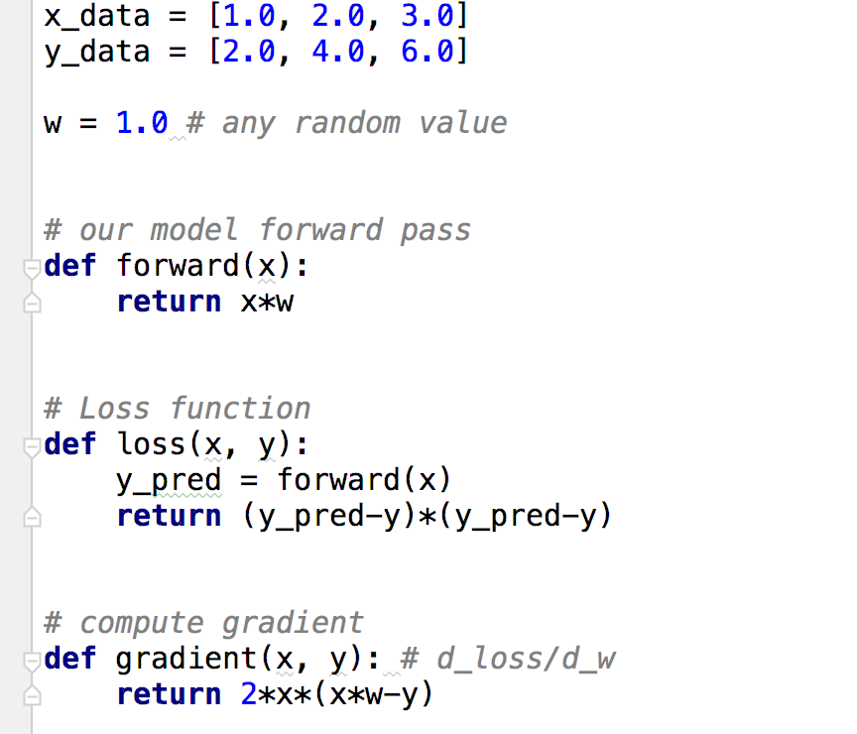
Data, Model, Loss, and Gradient

Slide 10
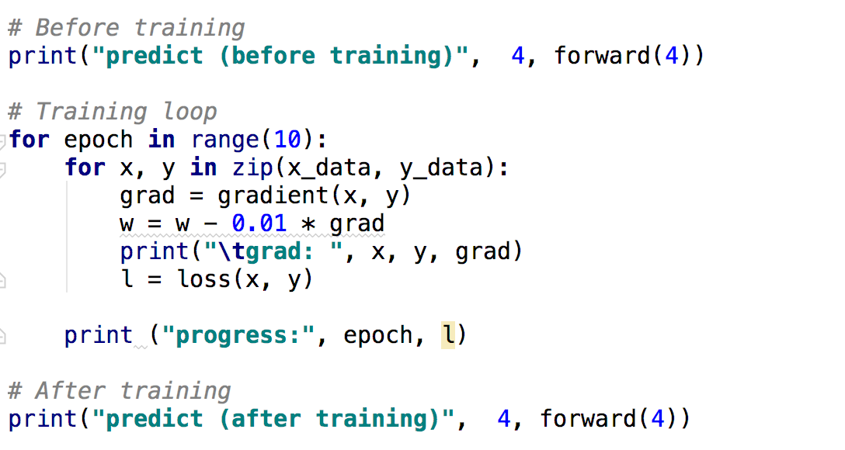
Training: updating weight

Slide 11
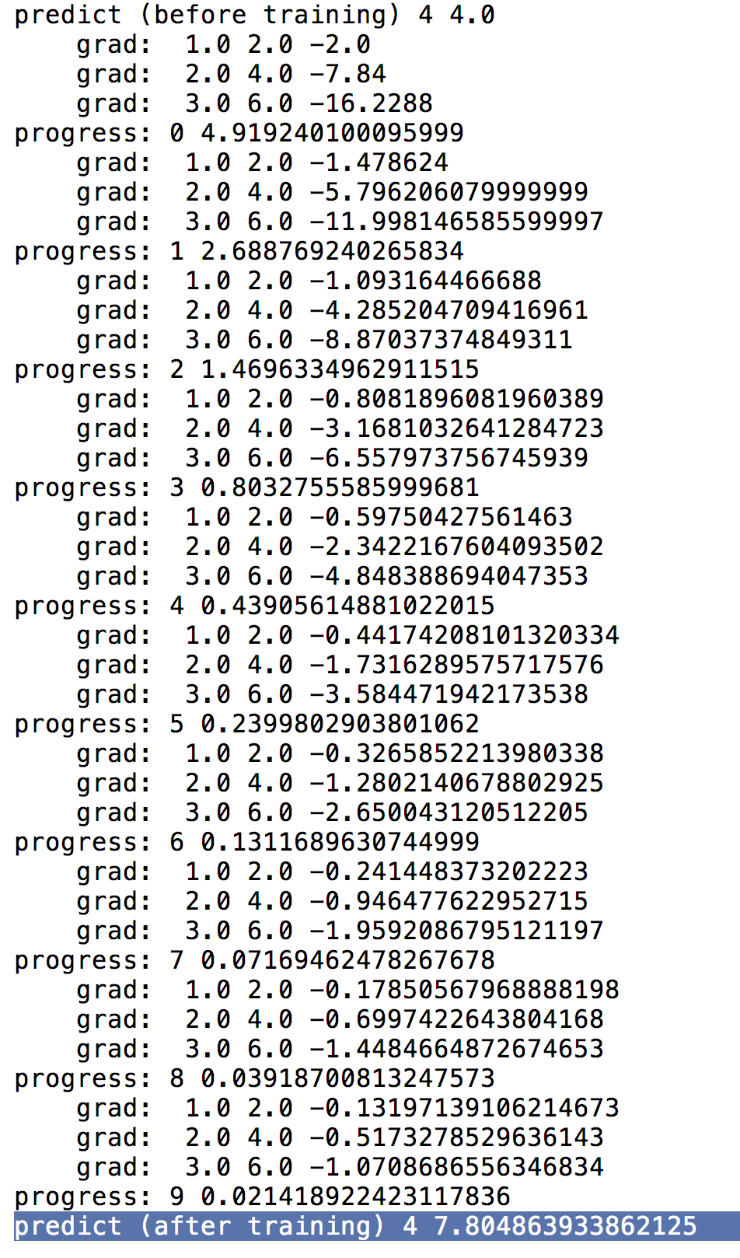
Output
(from gradient numeric computation)

Slide 12


Lecture 4:
Back-propagation

